Slide 1

By: Cypress Dauz
Josh Foster
Mohammed Hossain
Sidnee Skarda

Slide 2
York Directory Services
YDS
OBJECTIVE
Create and implement an Active Directory to best accommodate the Trinity School’s teachers, students, and staff. In addition to creating and implementing an active directory for the school, our group will also create an organized unit for the directory which includes users and devices, implementing DHCP and IP address scope, as well as creating and implementing both group and security policies for the school.
GOALS
Create the following:
Domain Controller
DHCP and IP address scope
Create OUs, Group & Security Policies
Login as a user in the network

Slide 3
CYPRESS
TEAM MEMBERS
JOSH
MOHAMMED
SIDNEE
Experience:
ITS Service Desk
Imaging/OS Deployment
Asset Management
Software & Hardware Installment
Tasks:
Install & Configure Windows Server
Install & Configure Active Directory
Install & Configure DHCP
Configure Firewall
Install Test PC with Windows 10
Connect Test PC to Trinity School network
Revising PowerPoint Slides (aka making it pretty!)
Experience:
Python and HTML
HCI
Microsoft Office Suite
Microsoft Project
Microsoft Visio
Tasks:
Create WBS
Create Gantt Chart
Create Google Docs & Slides
Revising of final deliverables (Final Report)
Experience:
Java Lab Assistant
Database Mgmt. Intern
HTML, Python & Java
Professional Procrastinator
Tasks:
Communications Table
Create Group Policies
Create Security Policies
Identifying the Risks and Mitigations
Experience:
5 years in IT
Java
Creating & Managing OUs
Tasks:
Create Organizational Units (OUs)
Create Naming Conventions for users and devices

Slide 4
RESOURCES
Microsoft PowerPoint, Project & Visio
Google Docs & Slides
Workstation / Remote Machine
Towson VPN via AnyConnect Secure Mobility Client
Remote Desktop Connection (Windows)
Microsoft Remote Desktop (MacOS)
VMware Workstation Pro 16
Windows Server 2019 OS
Windows 10 Pro OS
Personal Computers & Laptops
Discord & iMessage (Group Chat)

Slide 5
COMMUNICATION PLAN
PURPOSE | FREQUENCY | METHOD | AUDIENCE
Project Team Meeting | Every Tuesday & Thursday | In-Person & Discord | All Group Members
Task Progress Updates | Every Week | iMessage GC & In-Person | All Group Members
Update Professor McGuire | Every Tuesday | In-Person & Emails | All Group Members
Project Review | At Every Milestone | iMessage GC Discord In-Person | All Group Members

Slide 6
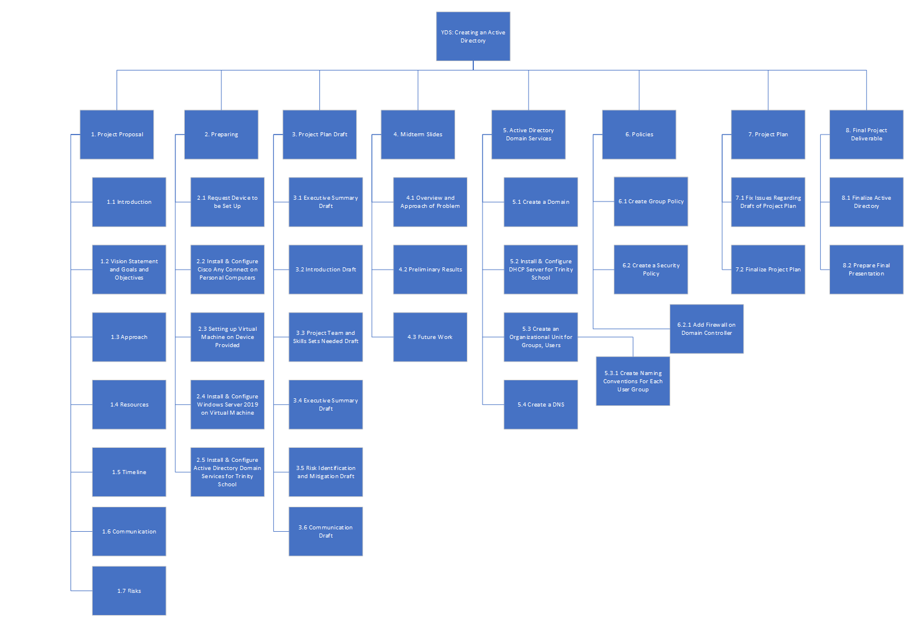
WORK BREAKDOWN STRUCTURE

Slide 7
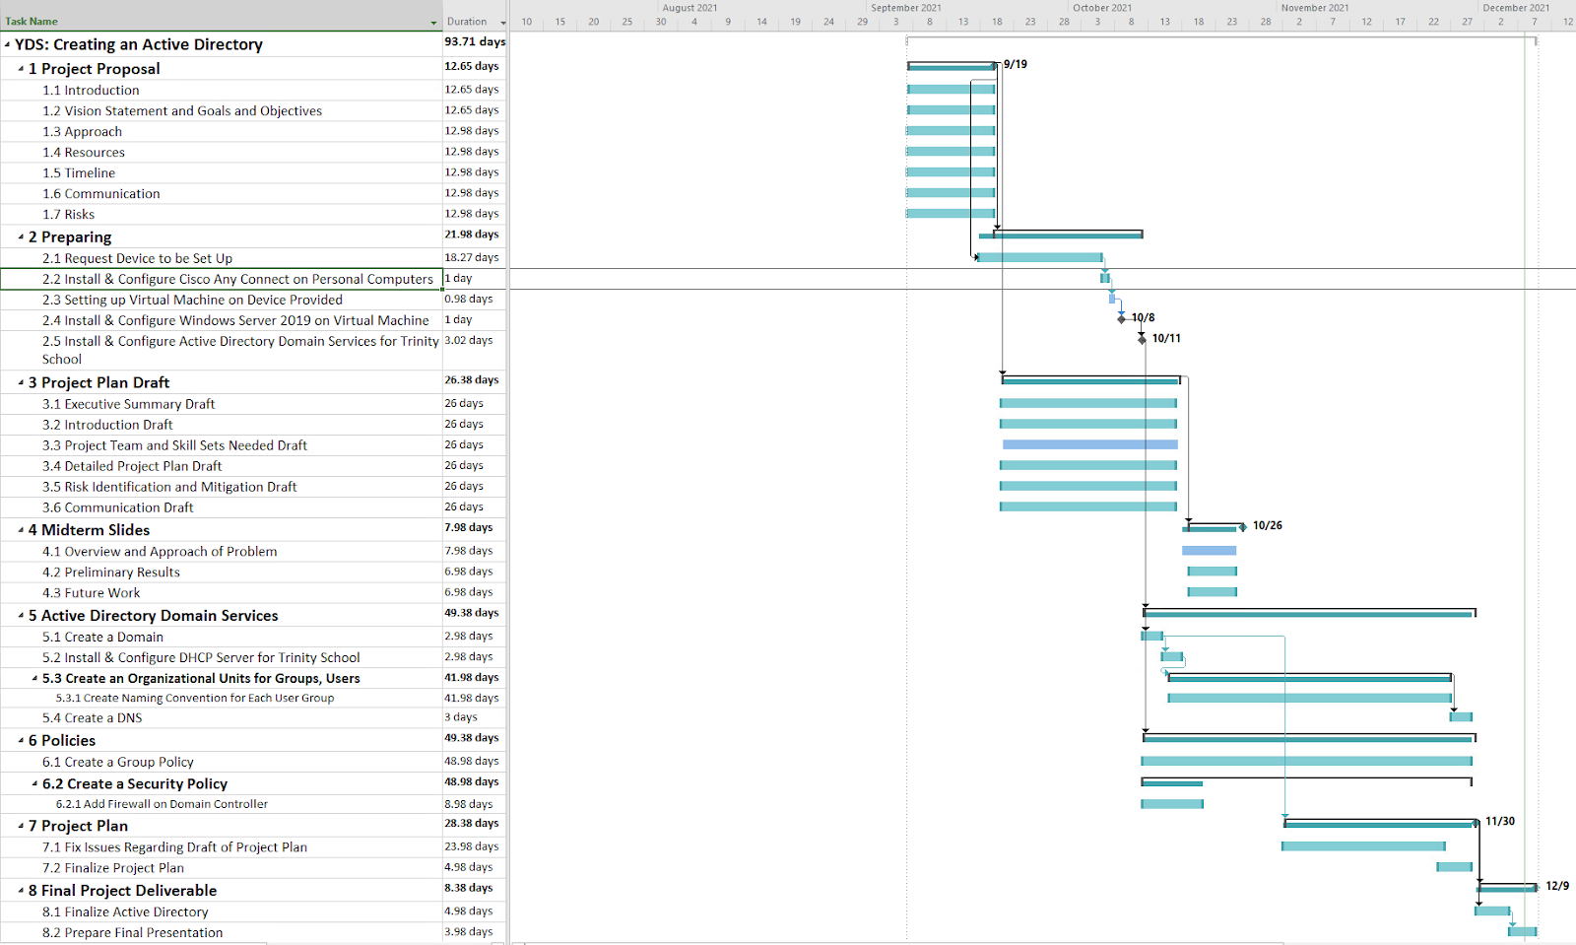
GANTT CHART

Slide 8
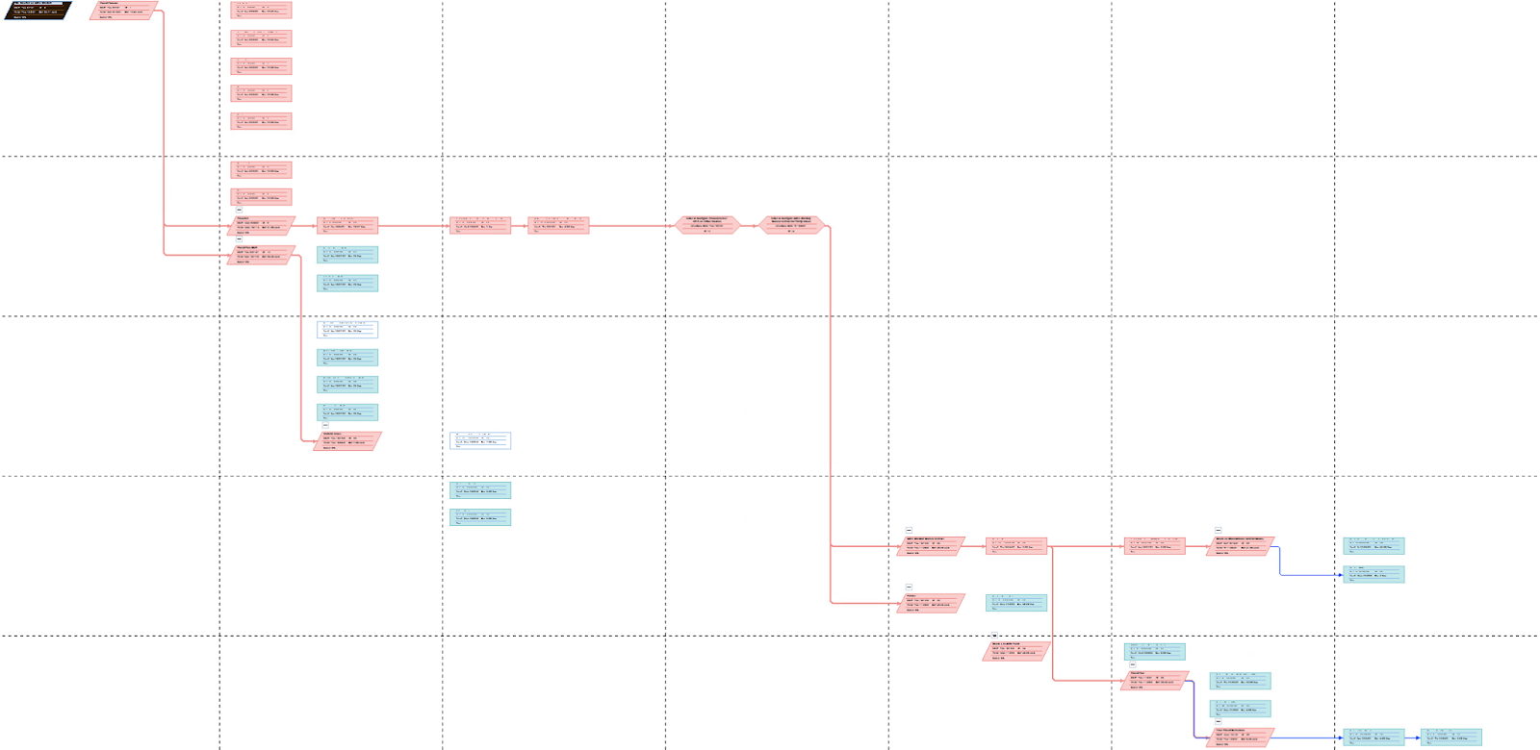
DEPENDENCY GRAPH

Slide 9
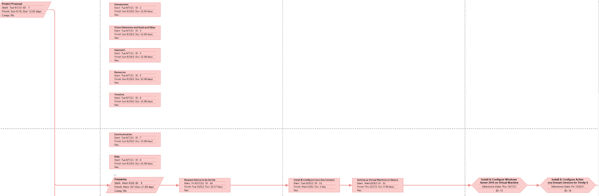
DEPENDENCY GRAPH

Slide 10
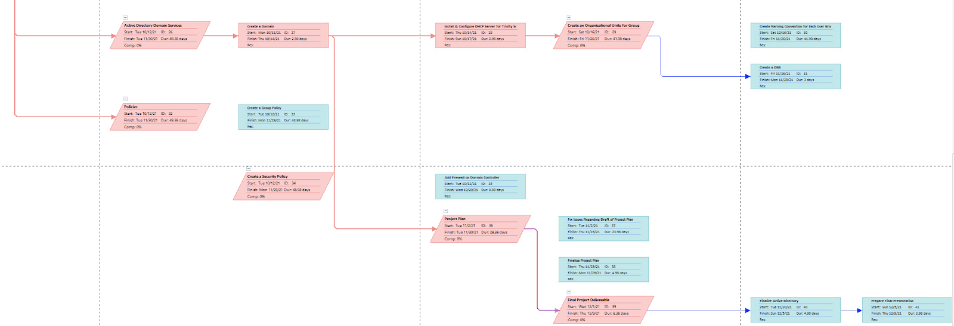
DEPENDENCY GRAPH

Slide 11
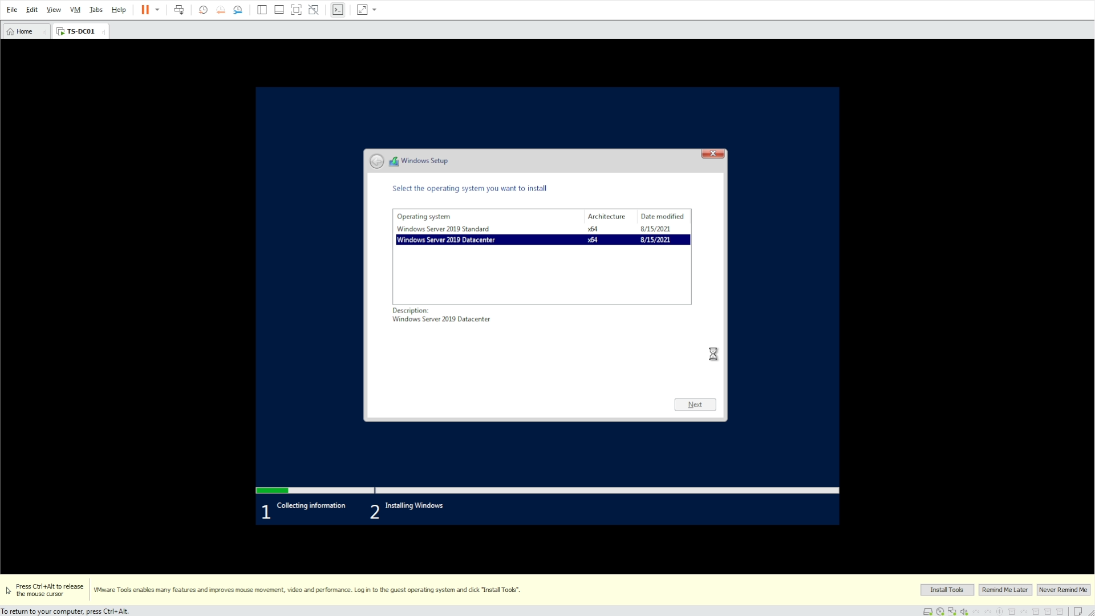
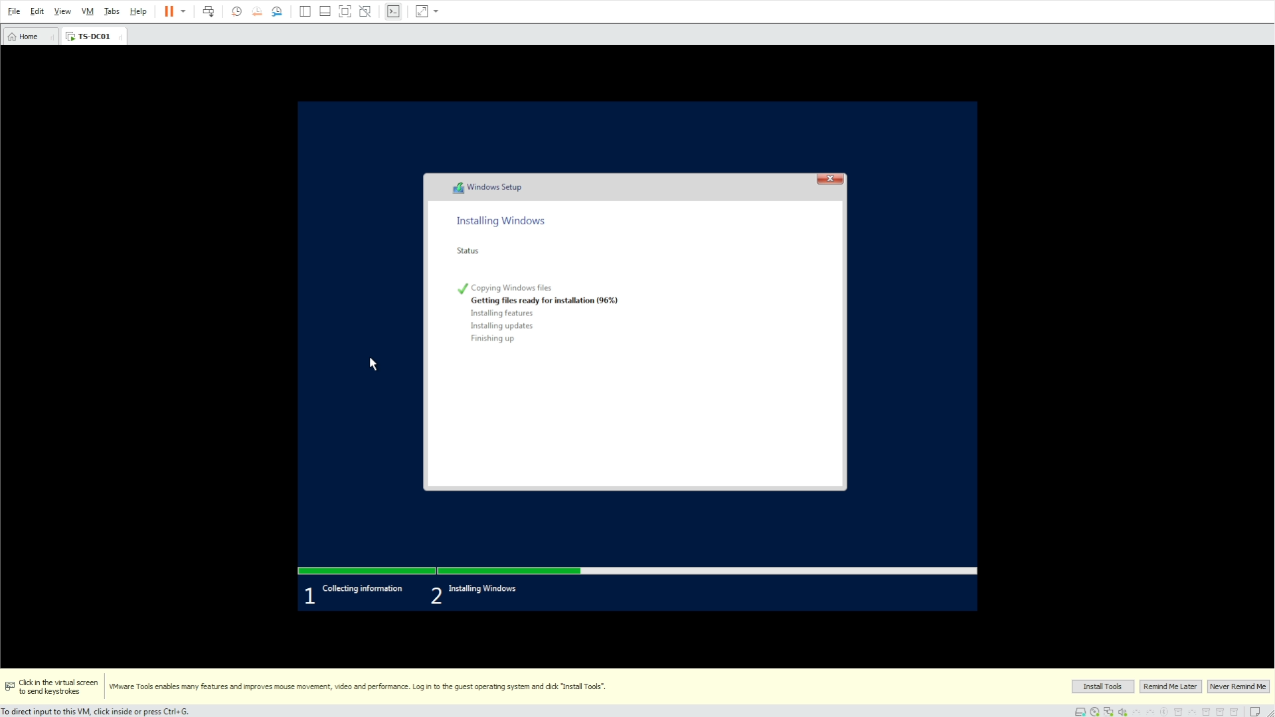
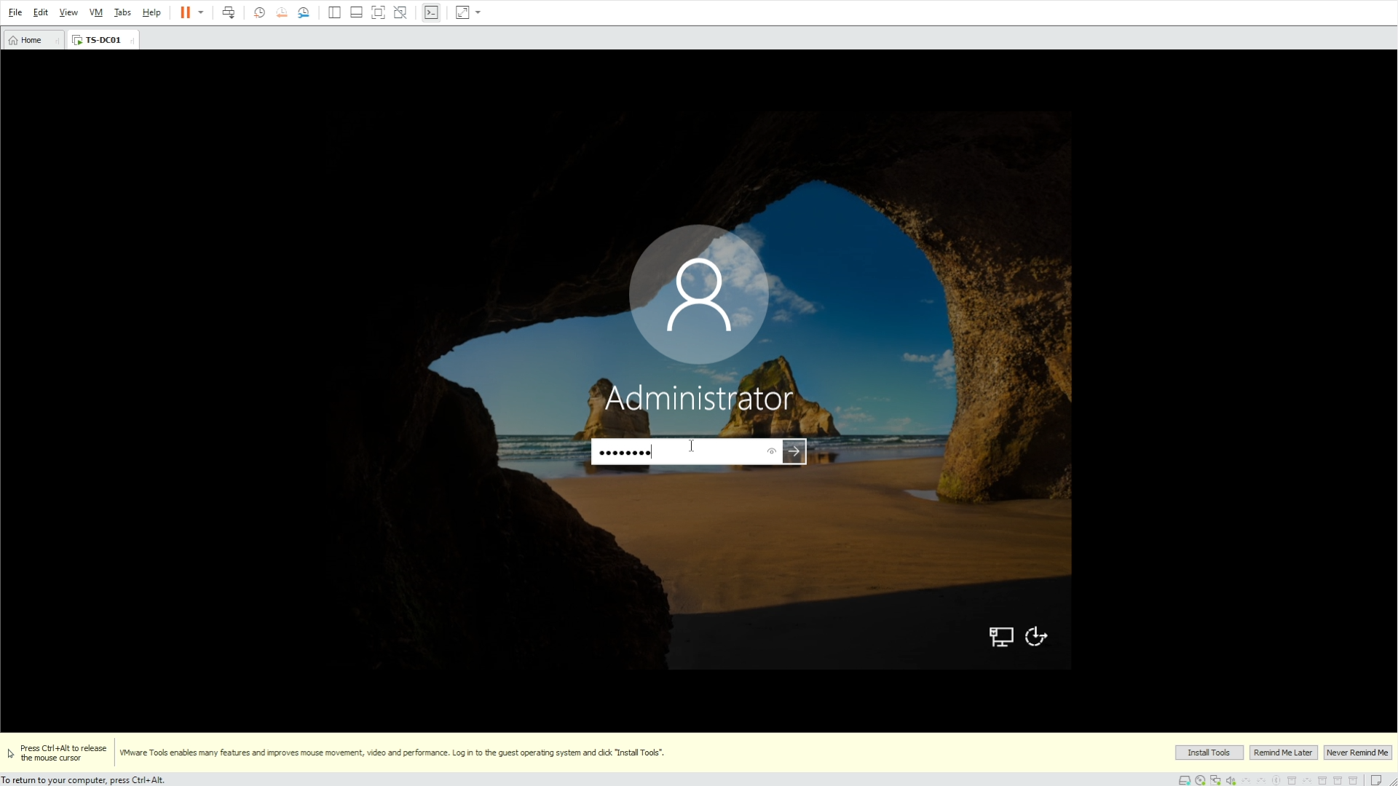
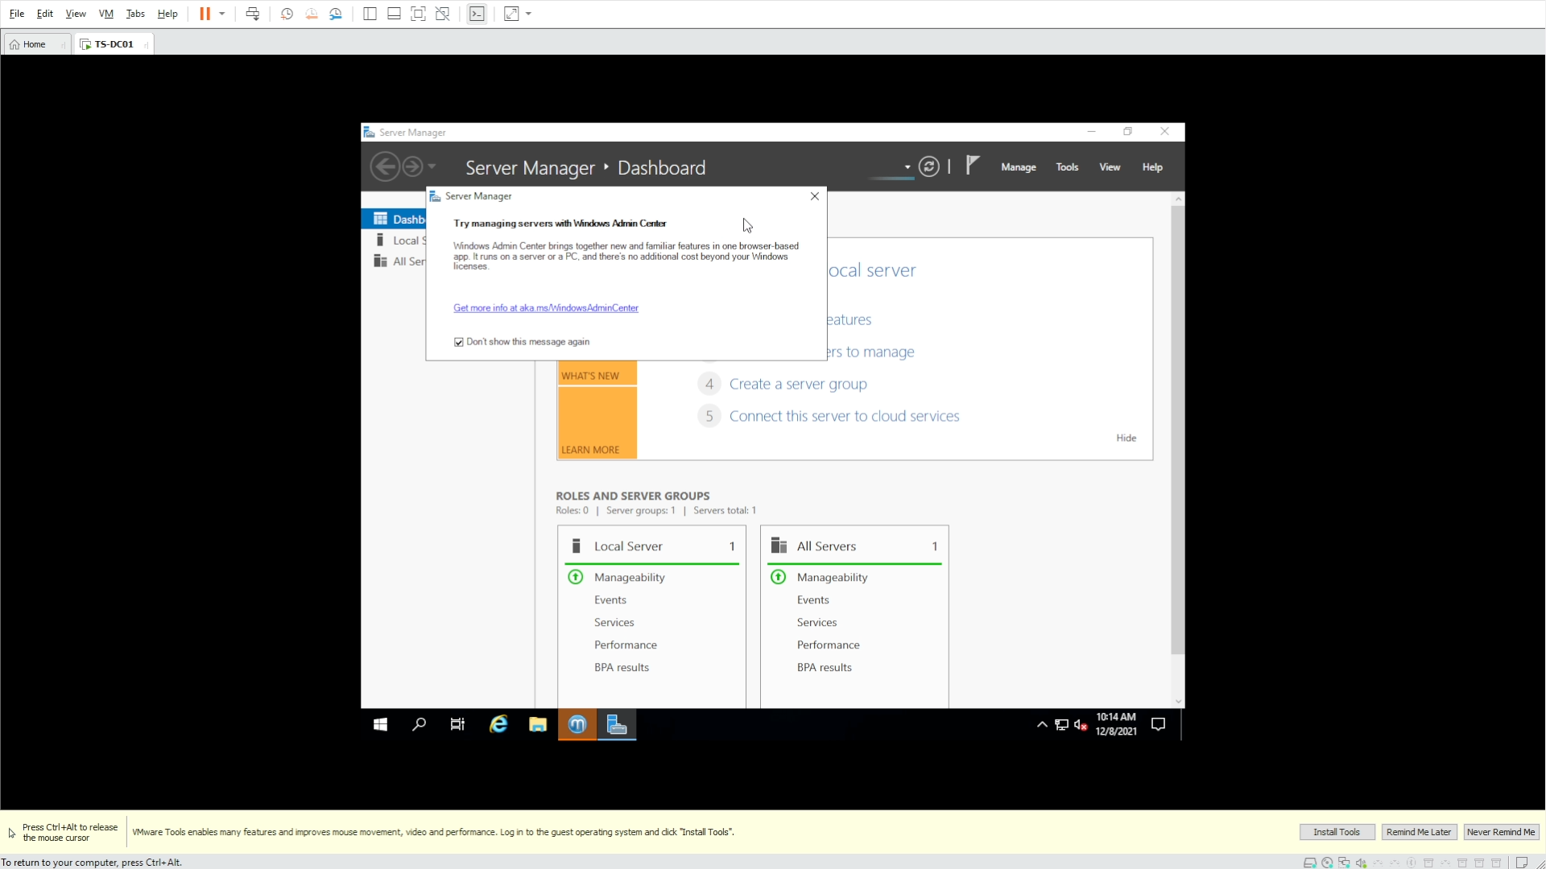
INSTALLING WINDOWS SERVER 2019

Slide 12
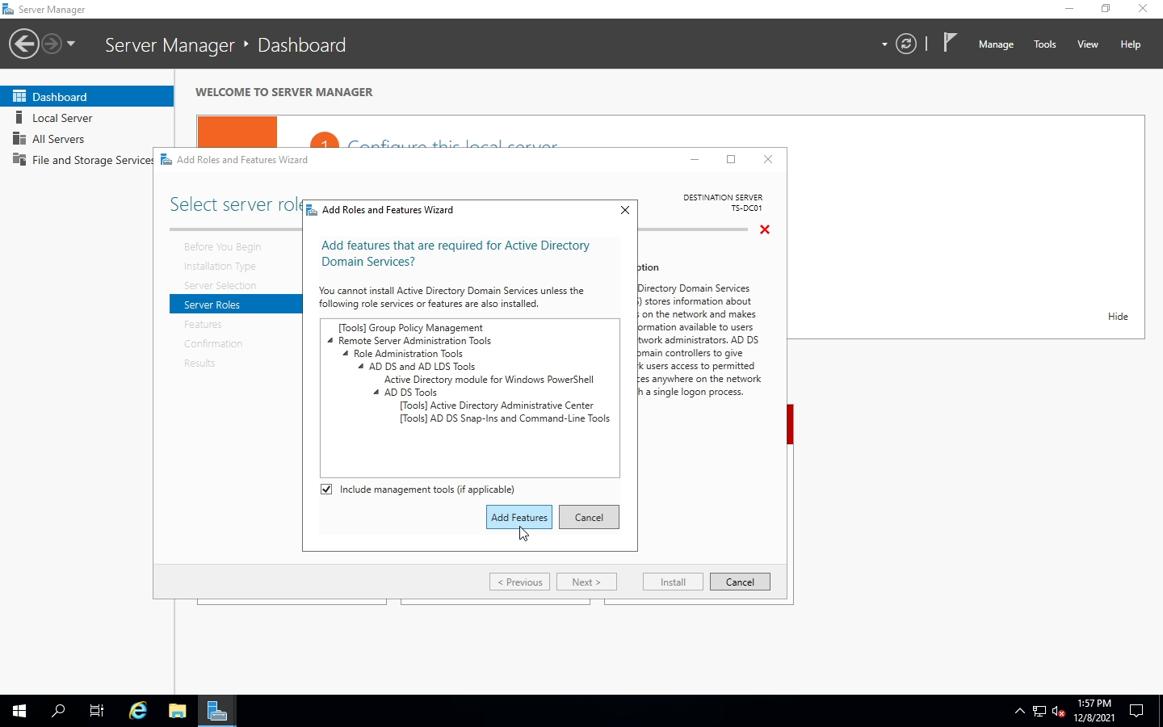
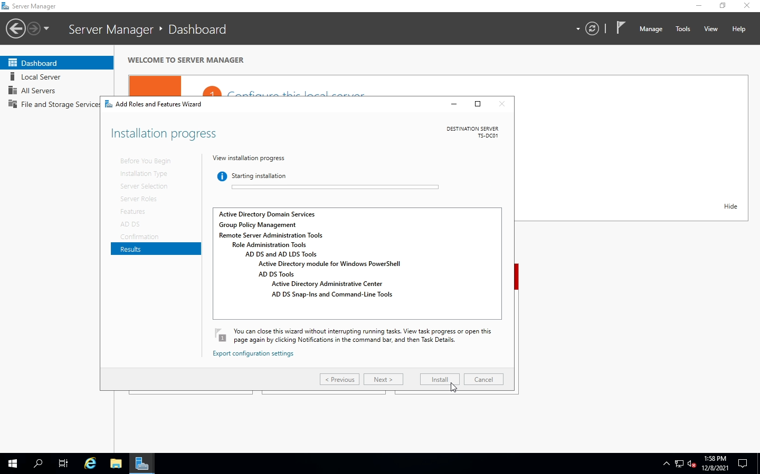
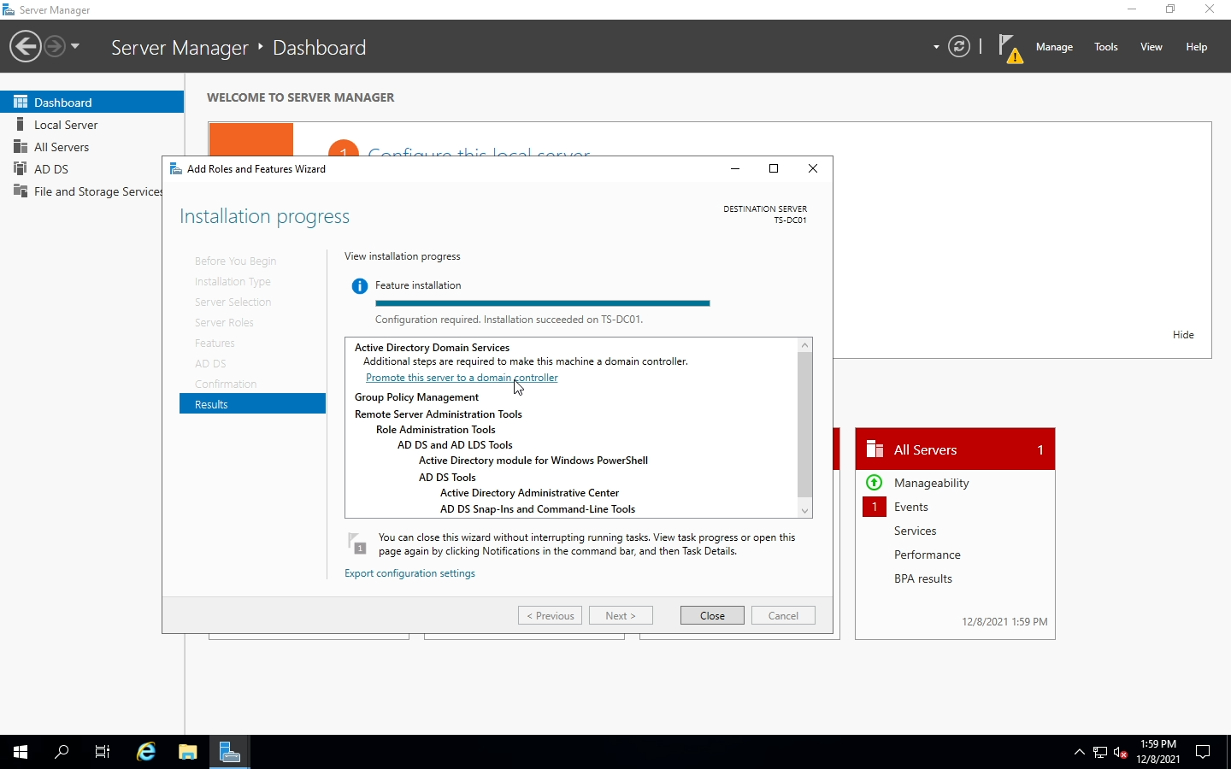
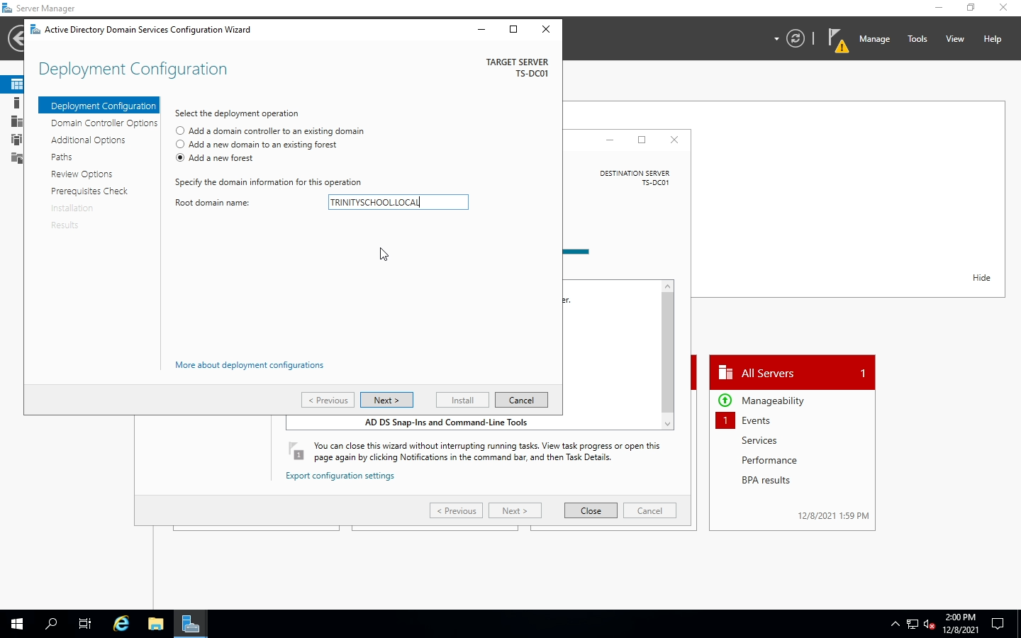
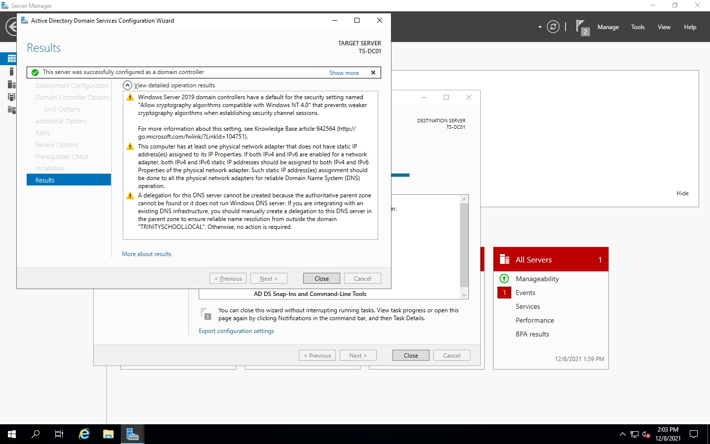
INSTALLING ACTIVE DIRECTORY

Slide 13
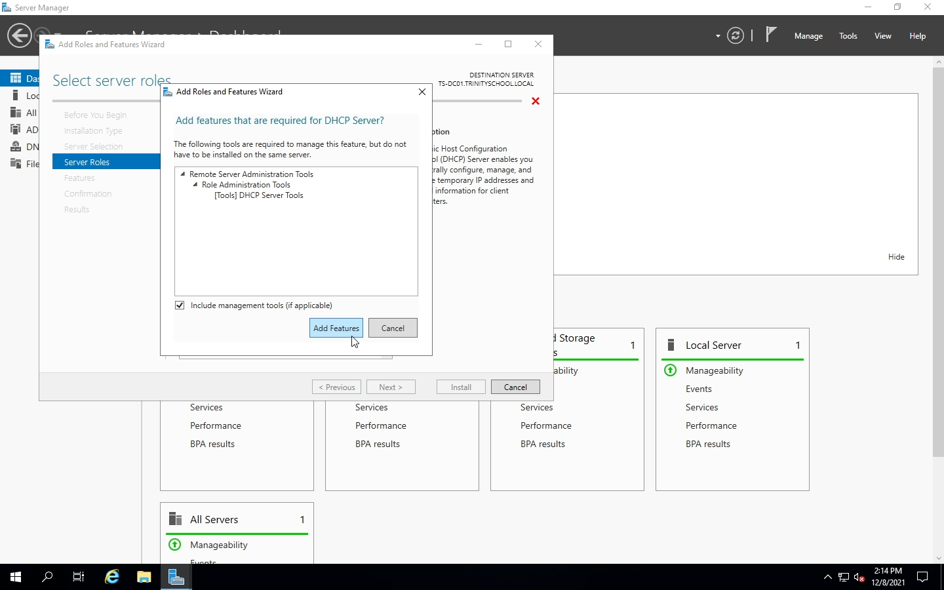
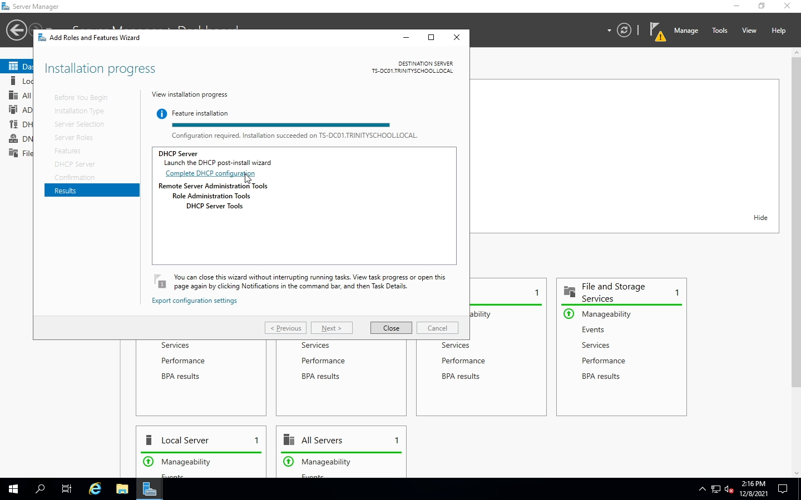
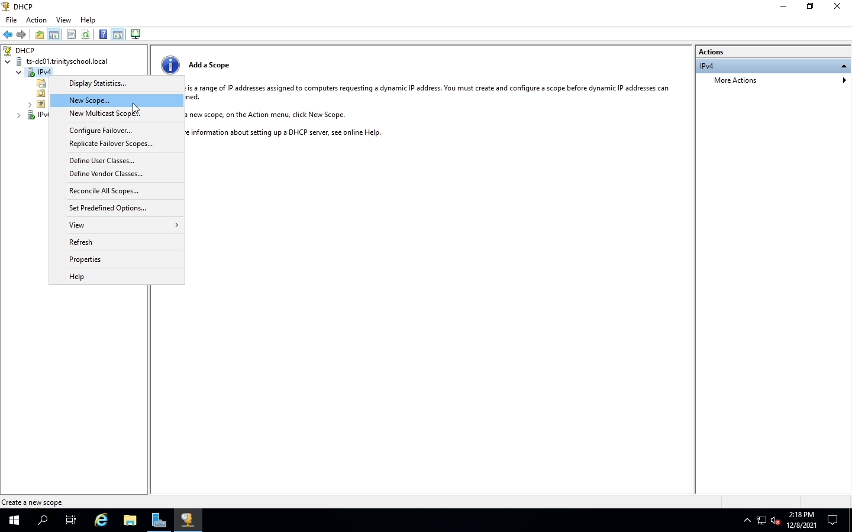
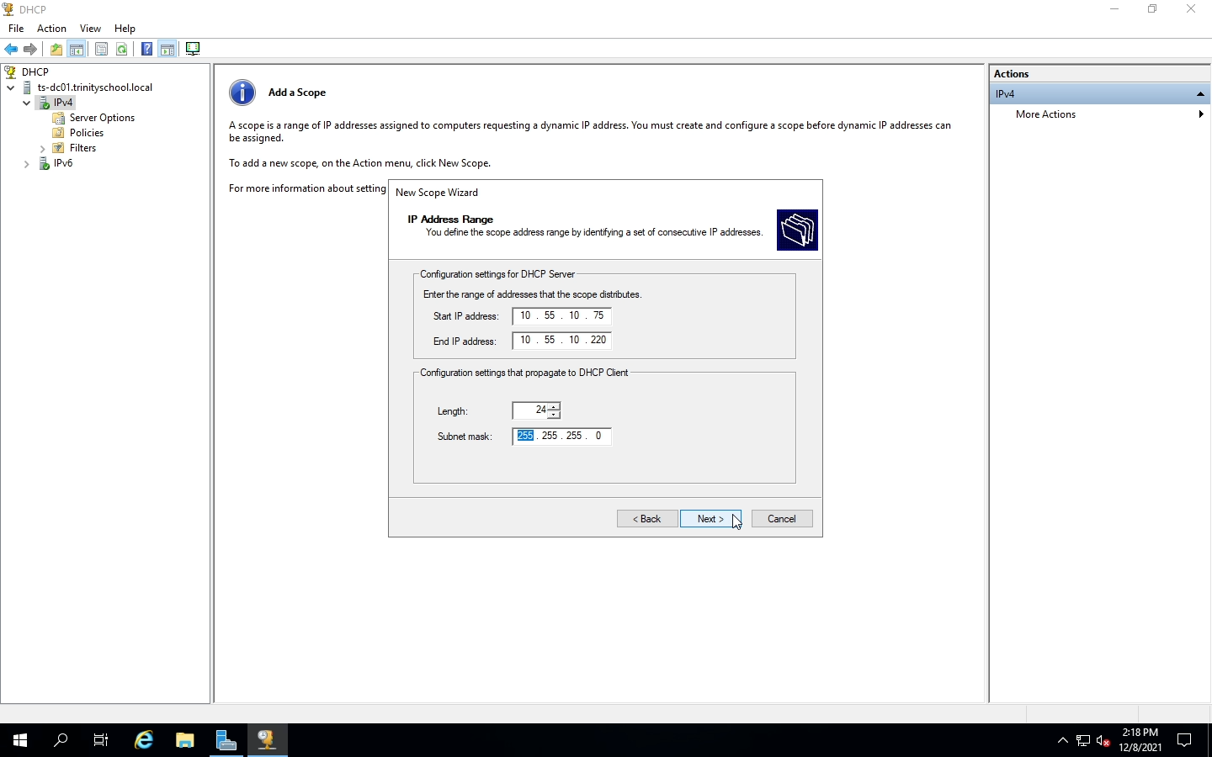
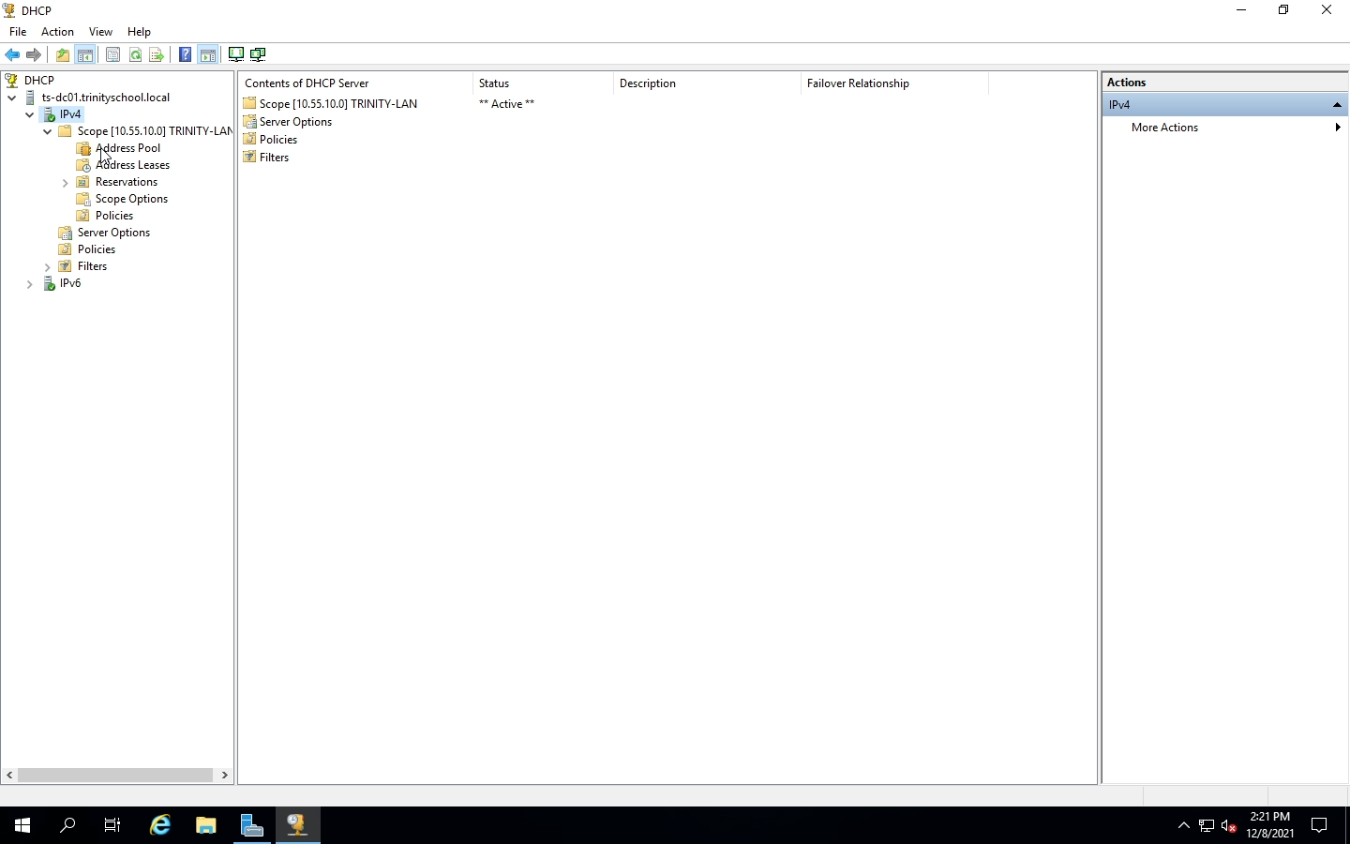
INSTALLING DHCP & IP ADDRESS SCOPE

Slide 14
NAMING CONVENTIONS FOR OUs
(The X displayed after the name represents the number of the PC)
LOCATION | NAMING CONVENTION
Classroom Desktops | CLASSPCXX
Computer Lab 1 | LAB1PCXX
Computer Lab 2 | LAB2PCXX
Front Office | FRONTPCX
Library | LIBPCX (specialty case: LIBHEADPCX)
IT Laptops | TRINITX
Student Laptops | TRINSTDTX
Teacher Laptops | TRINPROFX

Slide 15
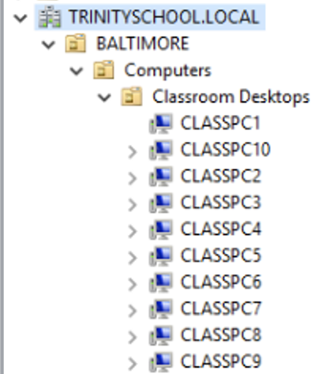
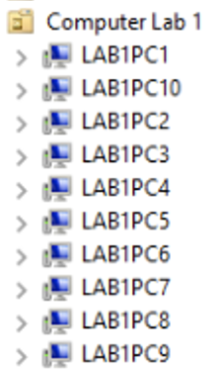
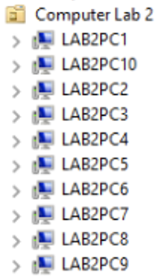
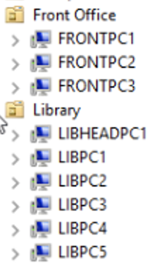
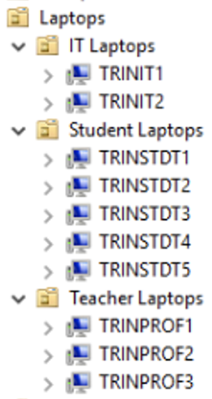
ORGANIZATIONAL UNITS (OUs)
The following are all sub folders for desktops and laptops in the OUs.

Slide 16
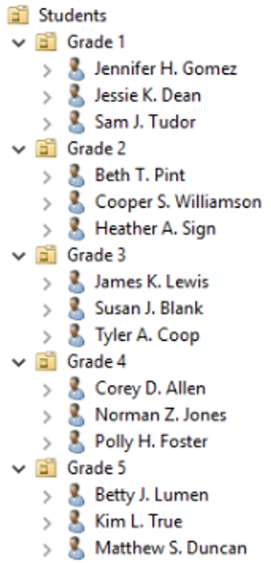
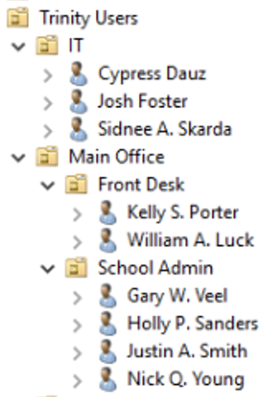
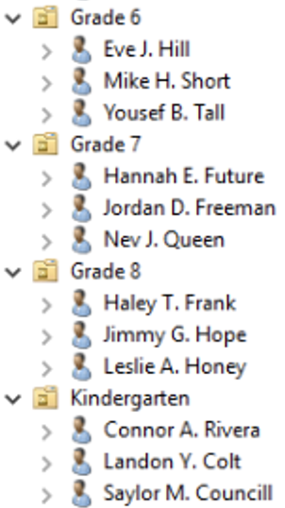
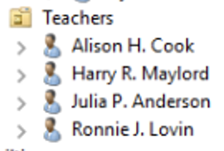
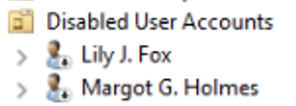
ORGANIZATIONAL UNITS (OUs)
The following are all sub folders for user accounts in the OUs.

Slide 17
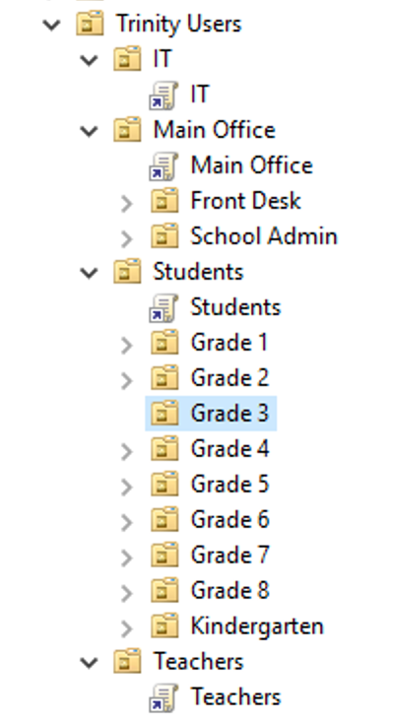
GROUP POLICIES FOLDERS

Slide 18
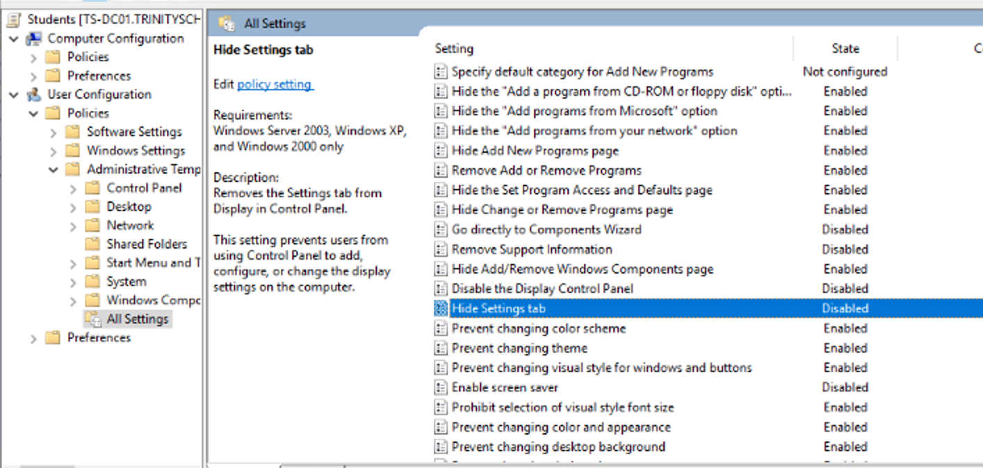
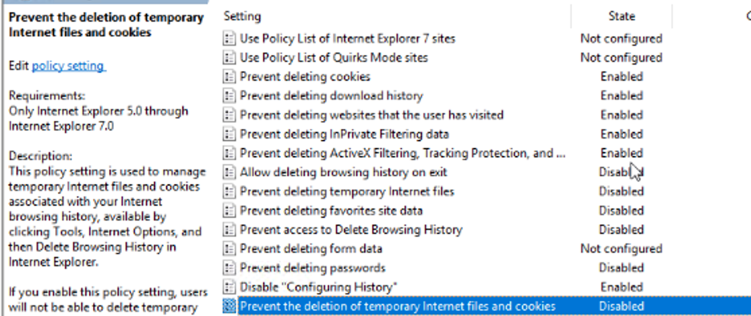
STUDENTS GROUP POLICIES

Slide 19
TEACHERS & FRONT OFFICE GROUP POLICIES

Slide 20
IT ADMINISTRATORS GROUP POLICIES

Slide 21
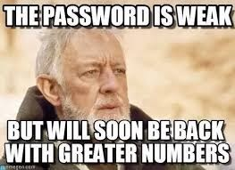
RISKS & MITIGATIONS
RISK | VULNERABILITY | IMPACT | MITIGATION
Inexperienced Users | Lack of Training | Causes confusion and lead to user errors; work needing to be repeated or corrected | Supply better training, and hire more experienced users
Short and simple Passwords | Inefficient passwords | Unauthorized user access | Training on creating better passwords Character requirements (8 characters or more, symbols)
Too Many Admins | Too many users with Admin Access | Can lead to privilege abuse | Reduce amount of admins
Leaving inactive accounts | Poor maintenance | Easy to compromise data | Inactive accounts should be disabled and then deleted to mitigate these risks

Slide 22
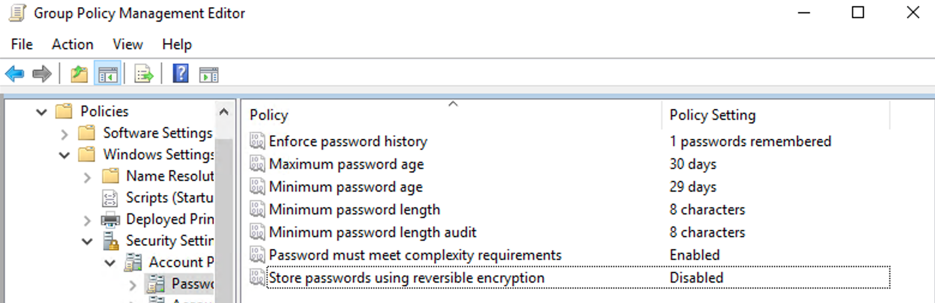
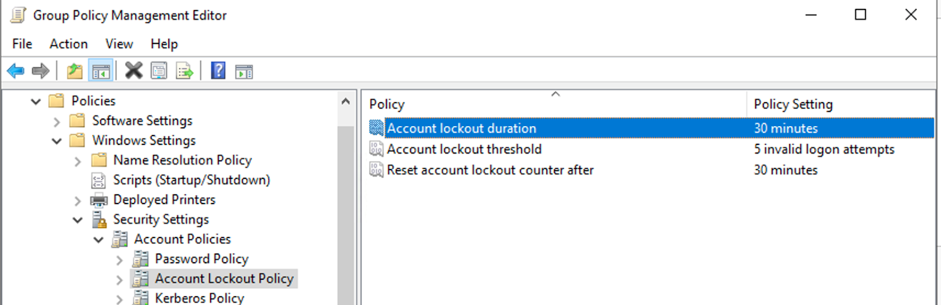
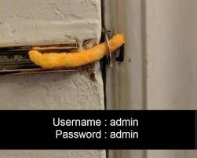
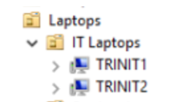
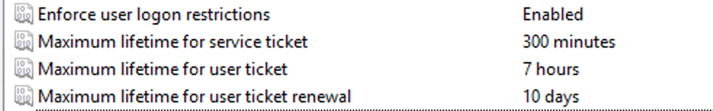
SECURITY POLICIES

Slide 23
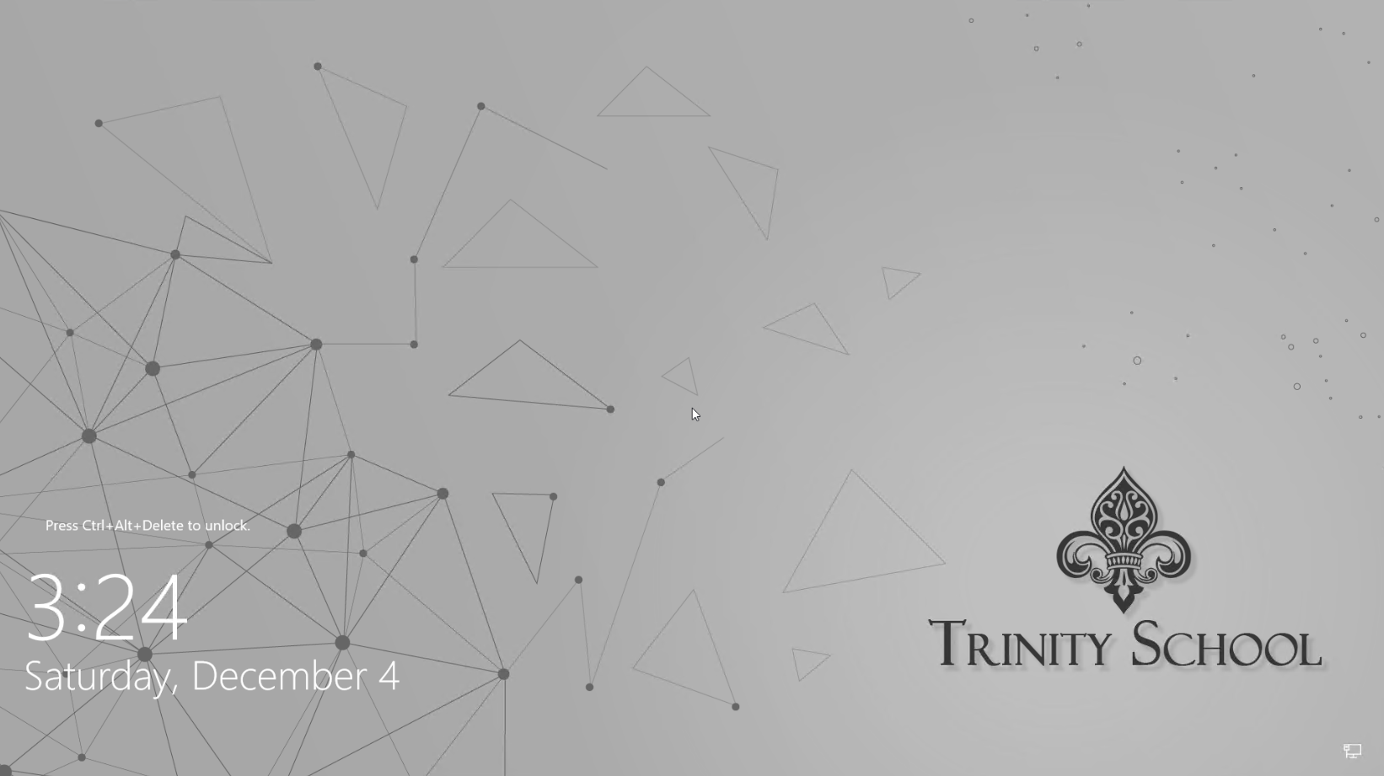

Slide 24
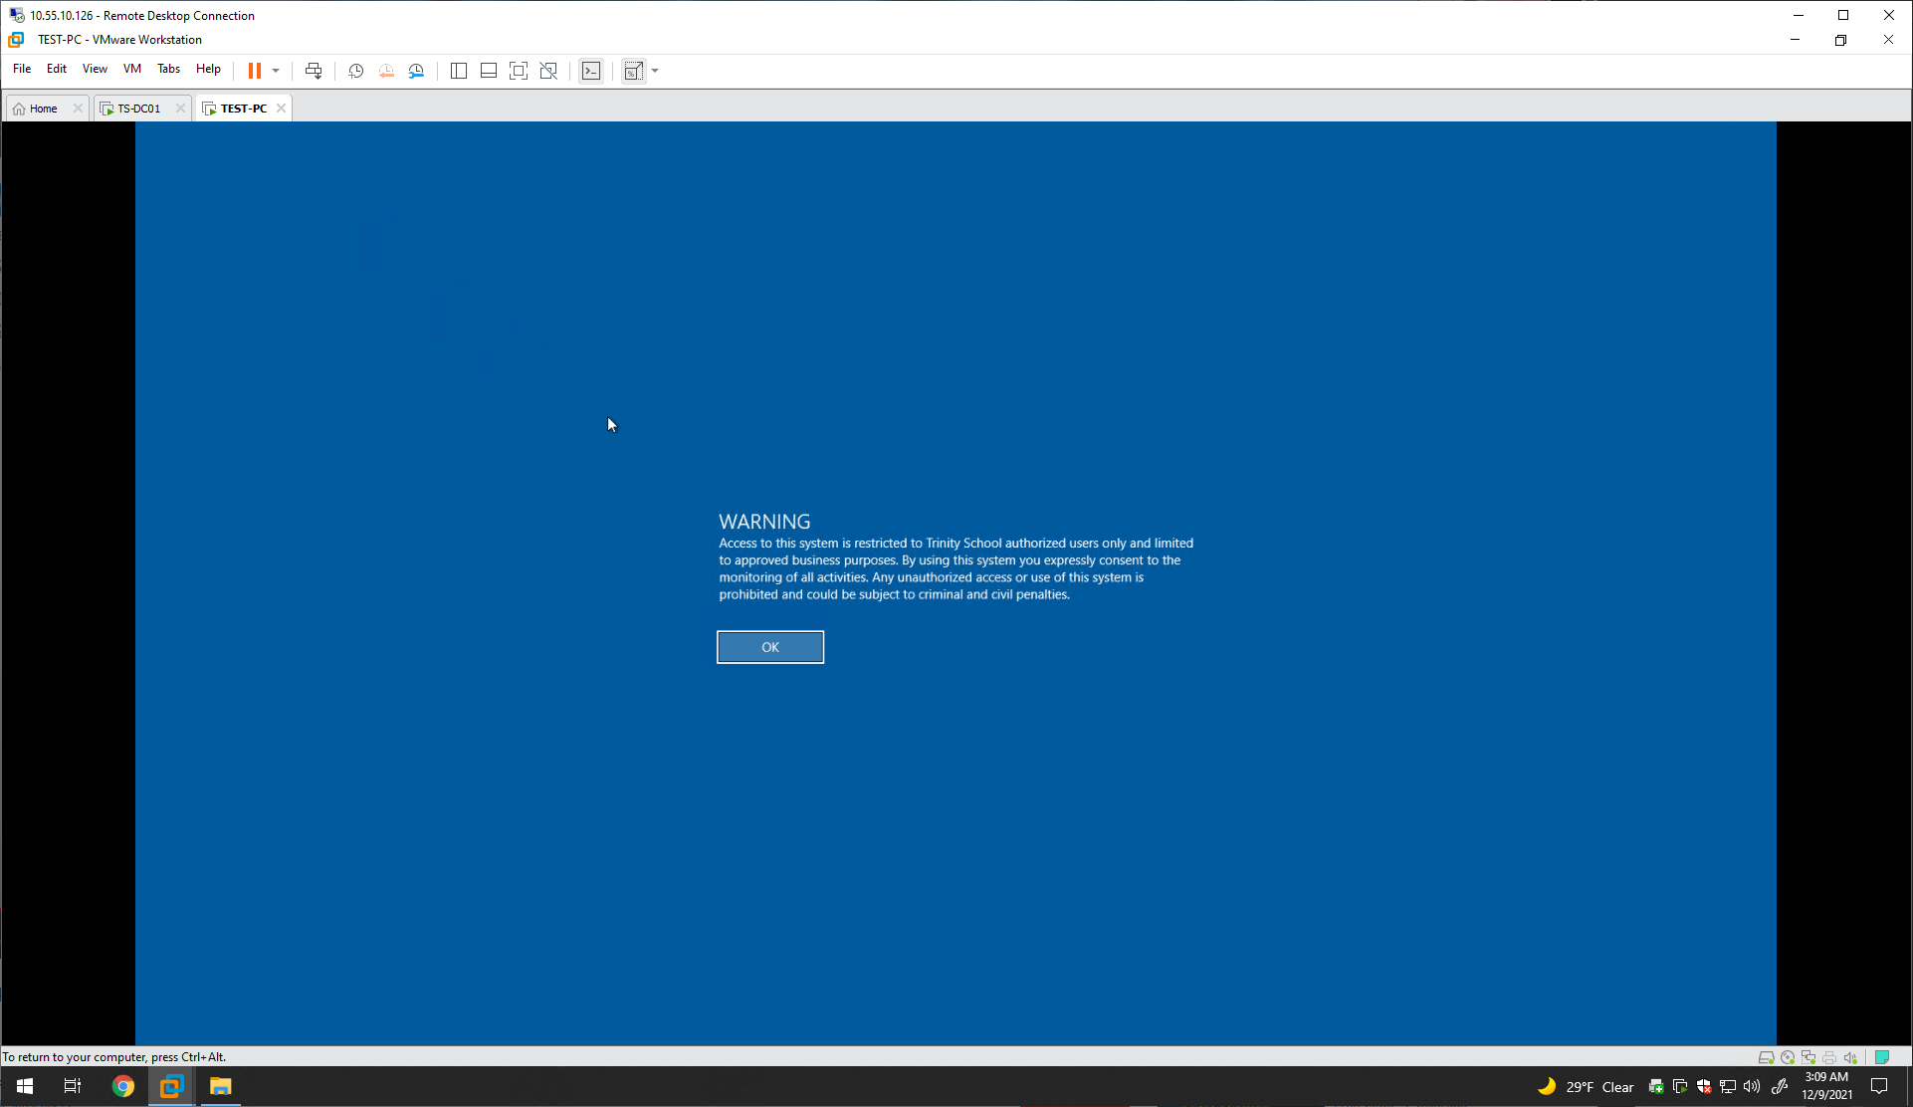

Slide 25
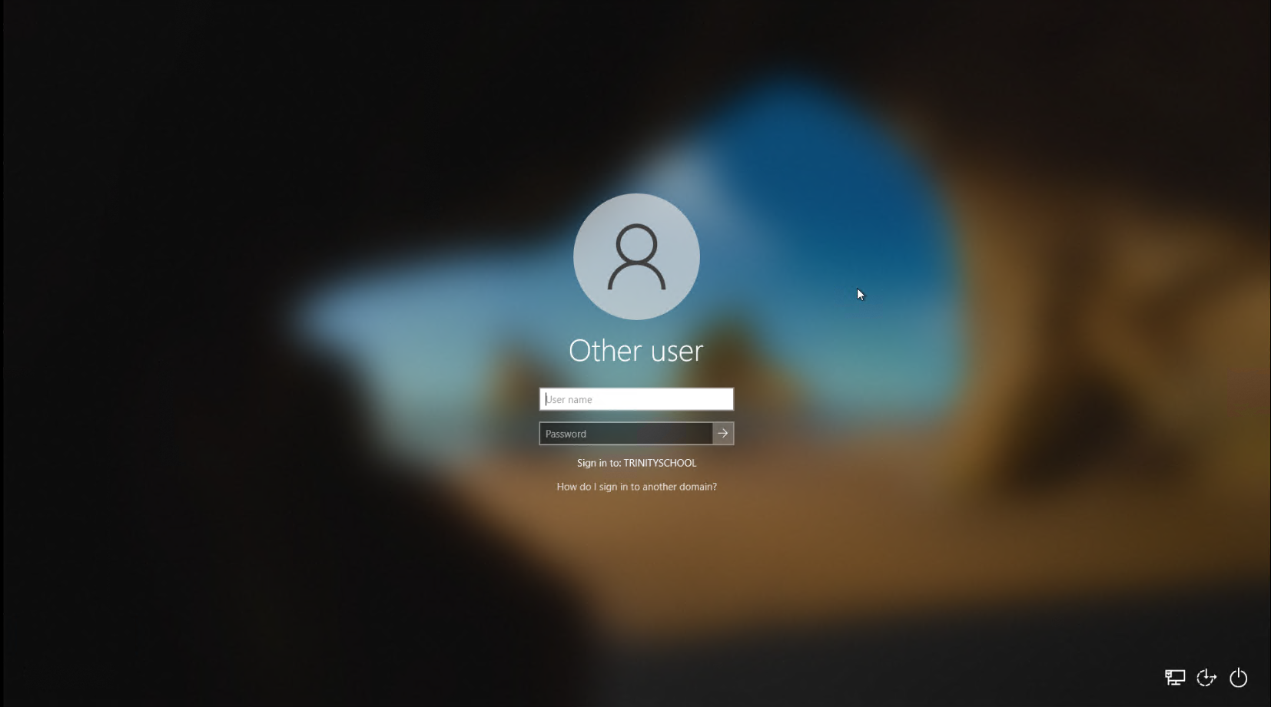

Slide 26
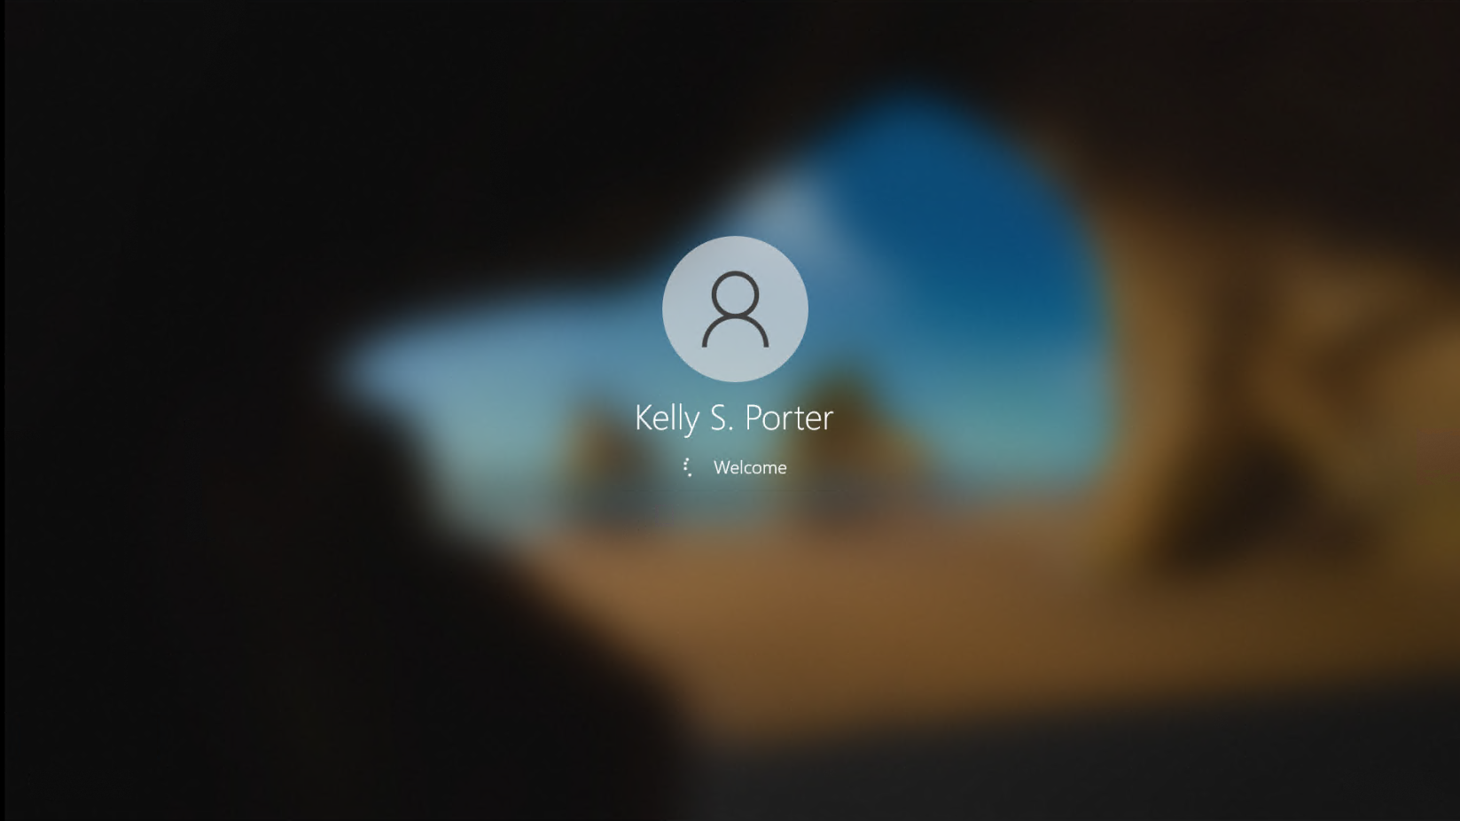

Slide 27
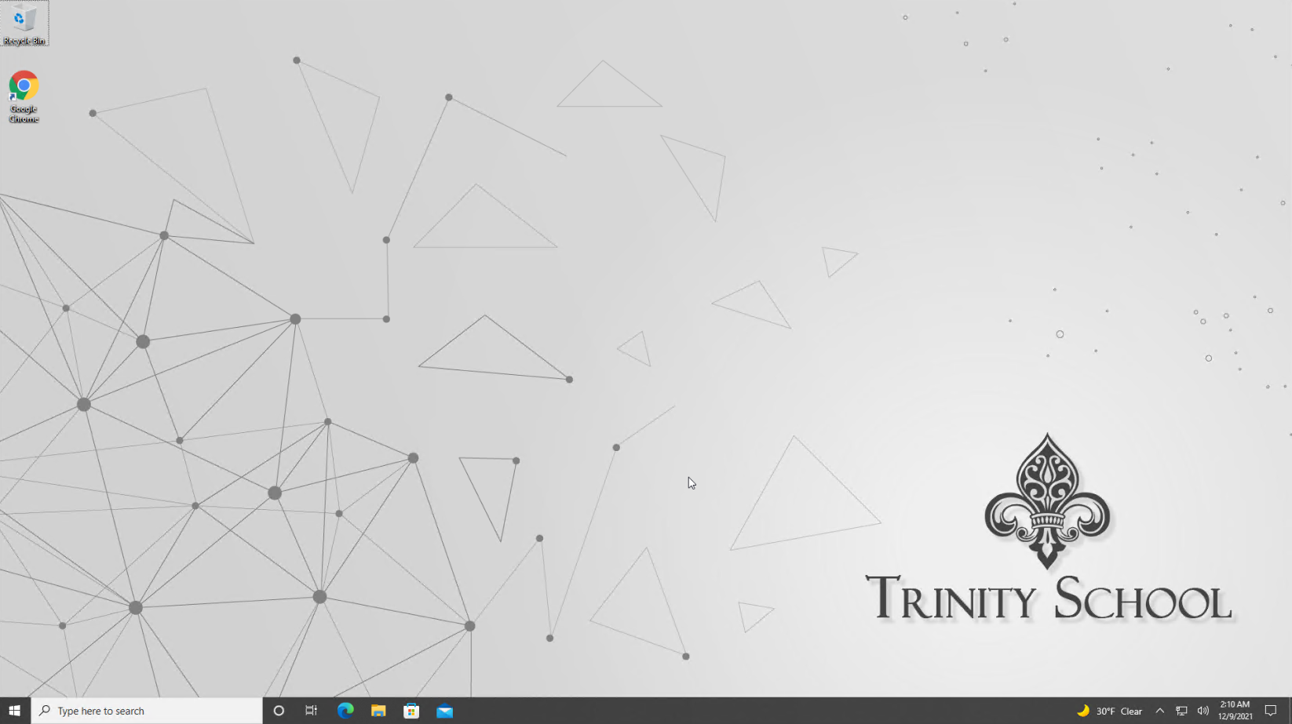
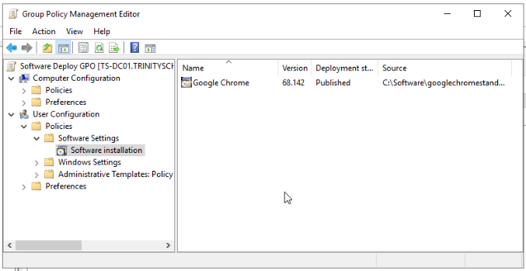
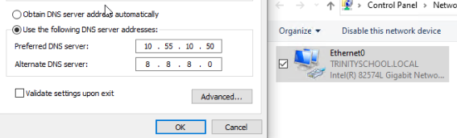

Slide 28
THANK YOU!

